Slide 1


Slide 2
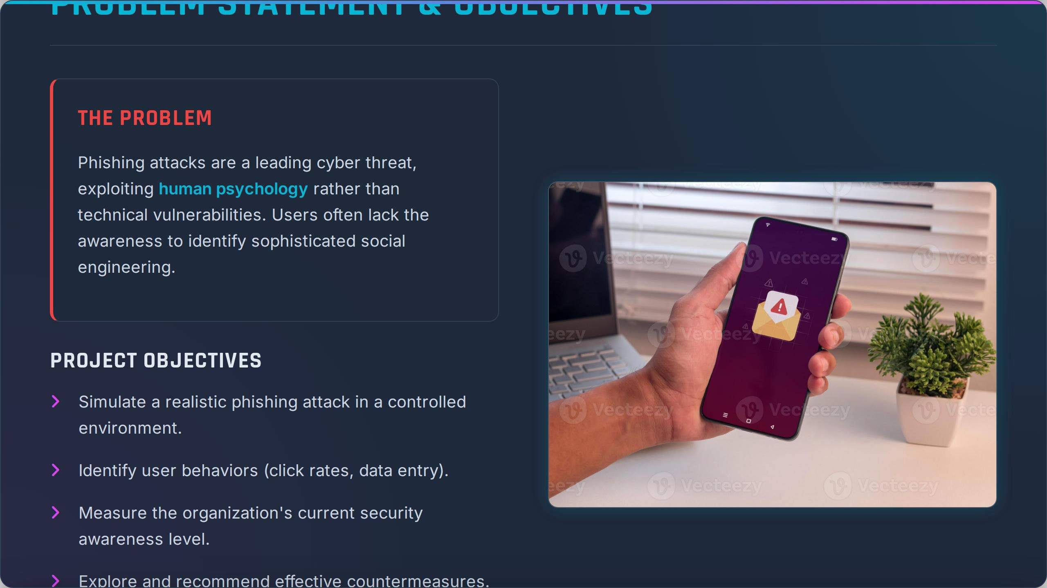

Slide 3
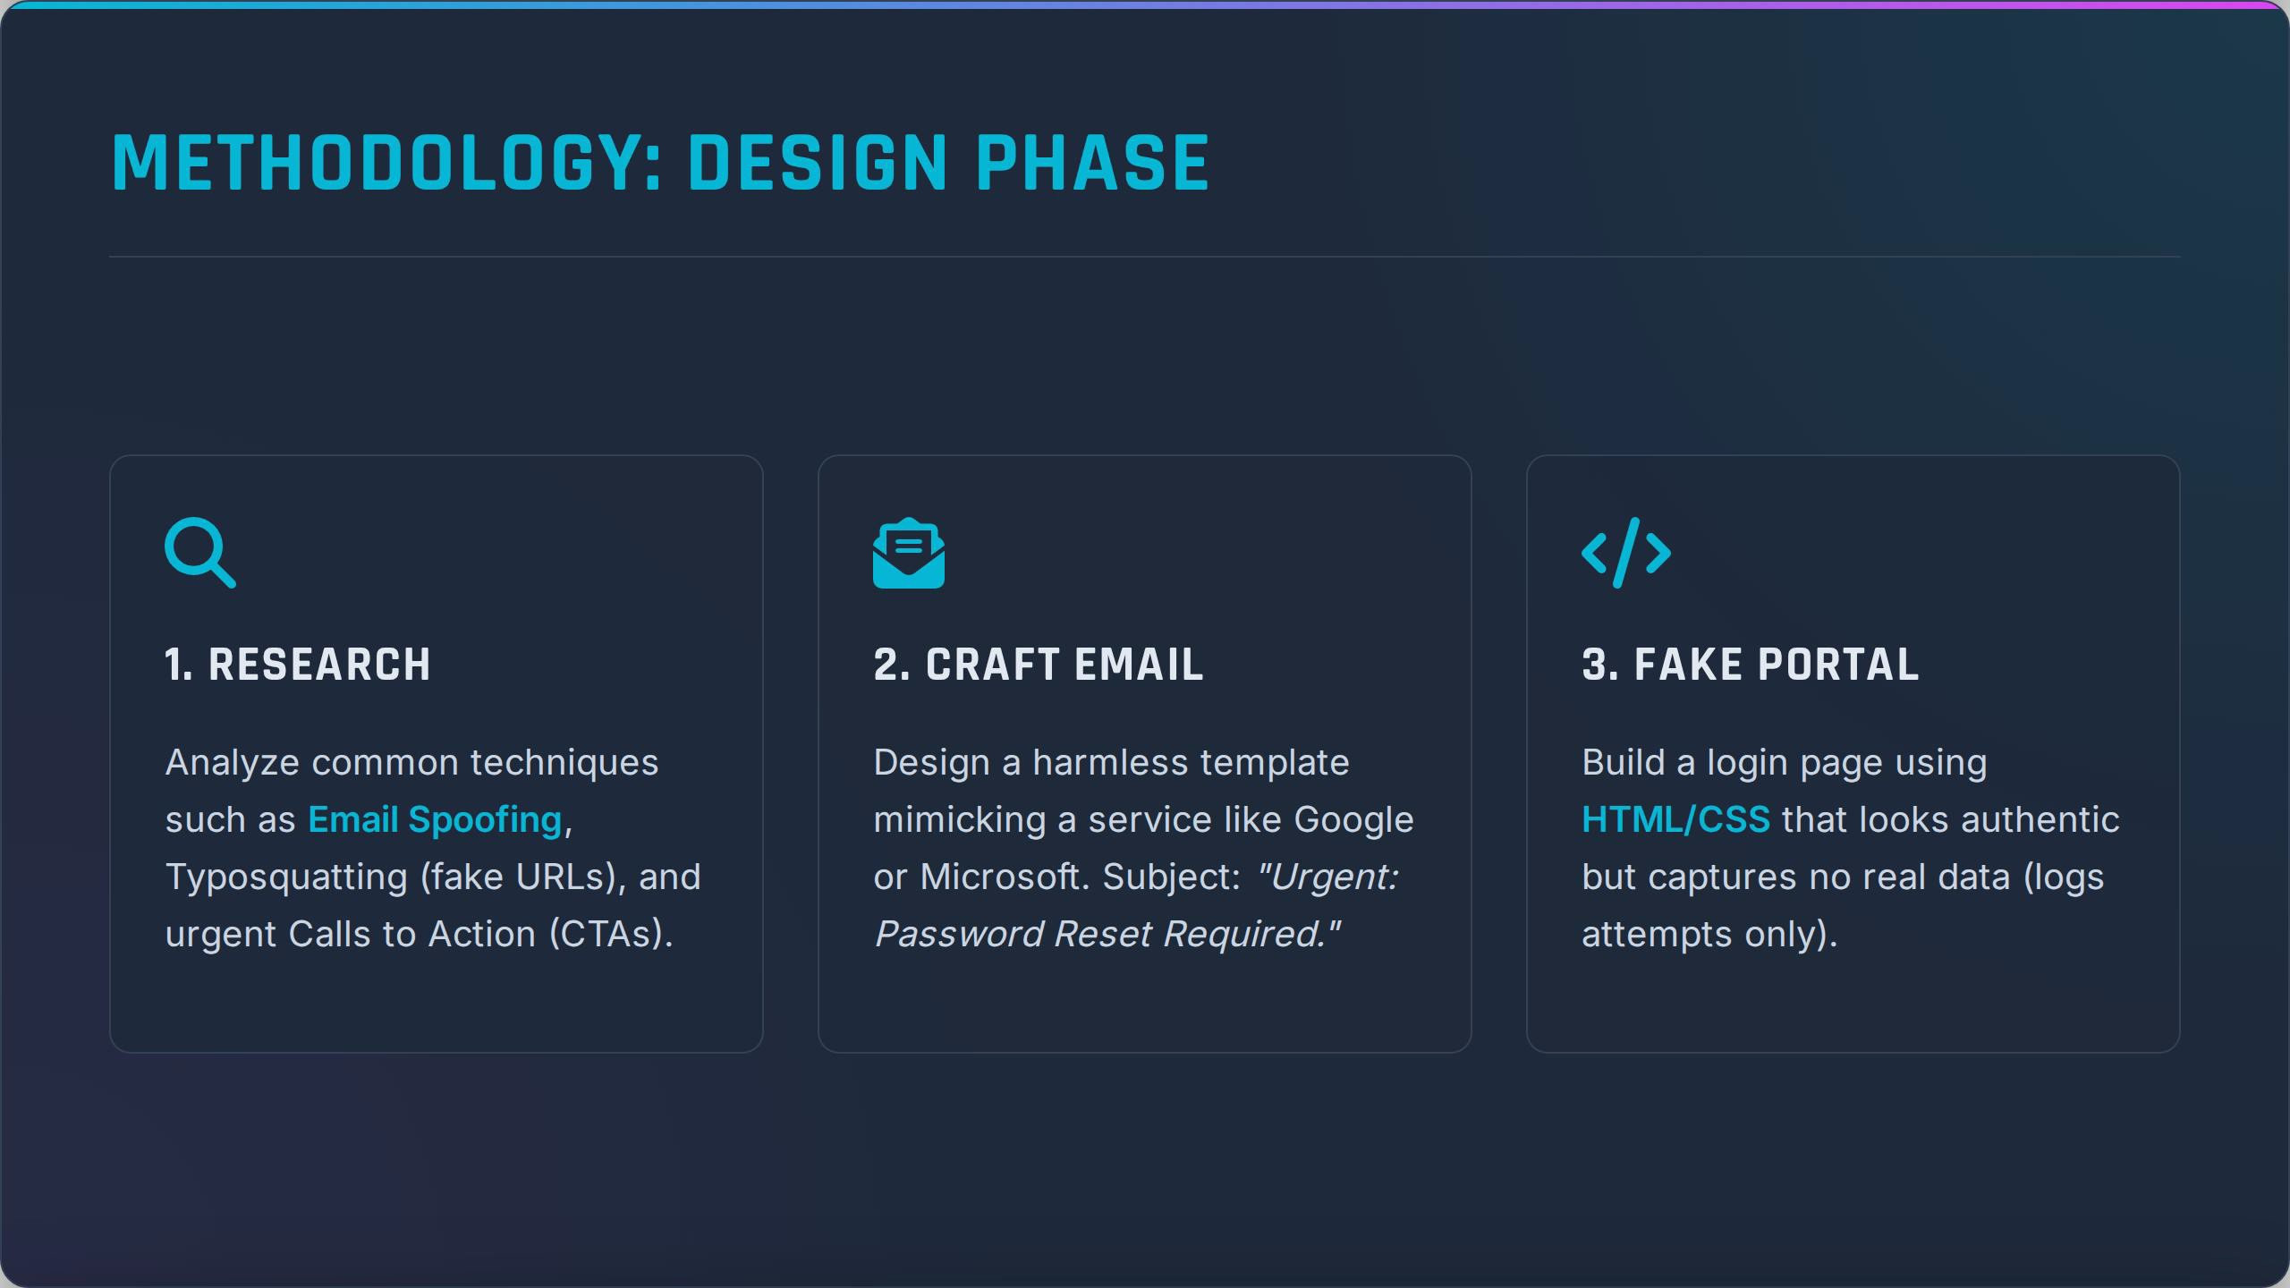

Slide 4
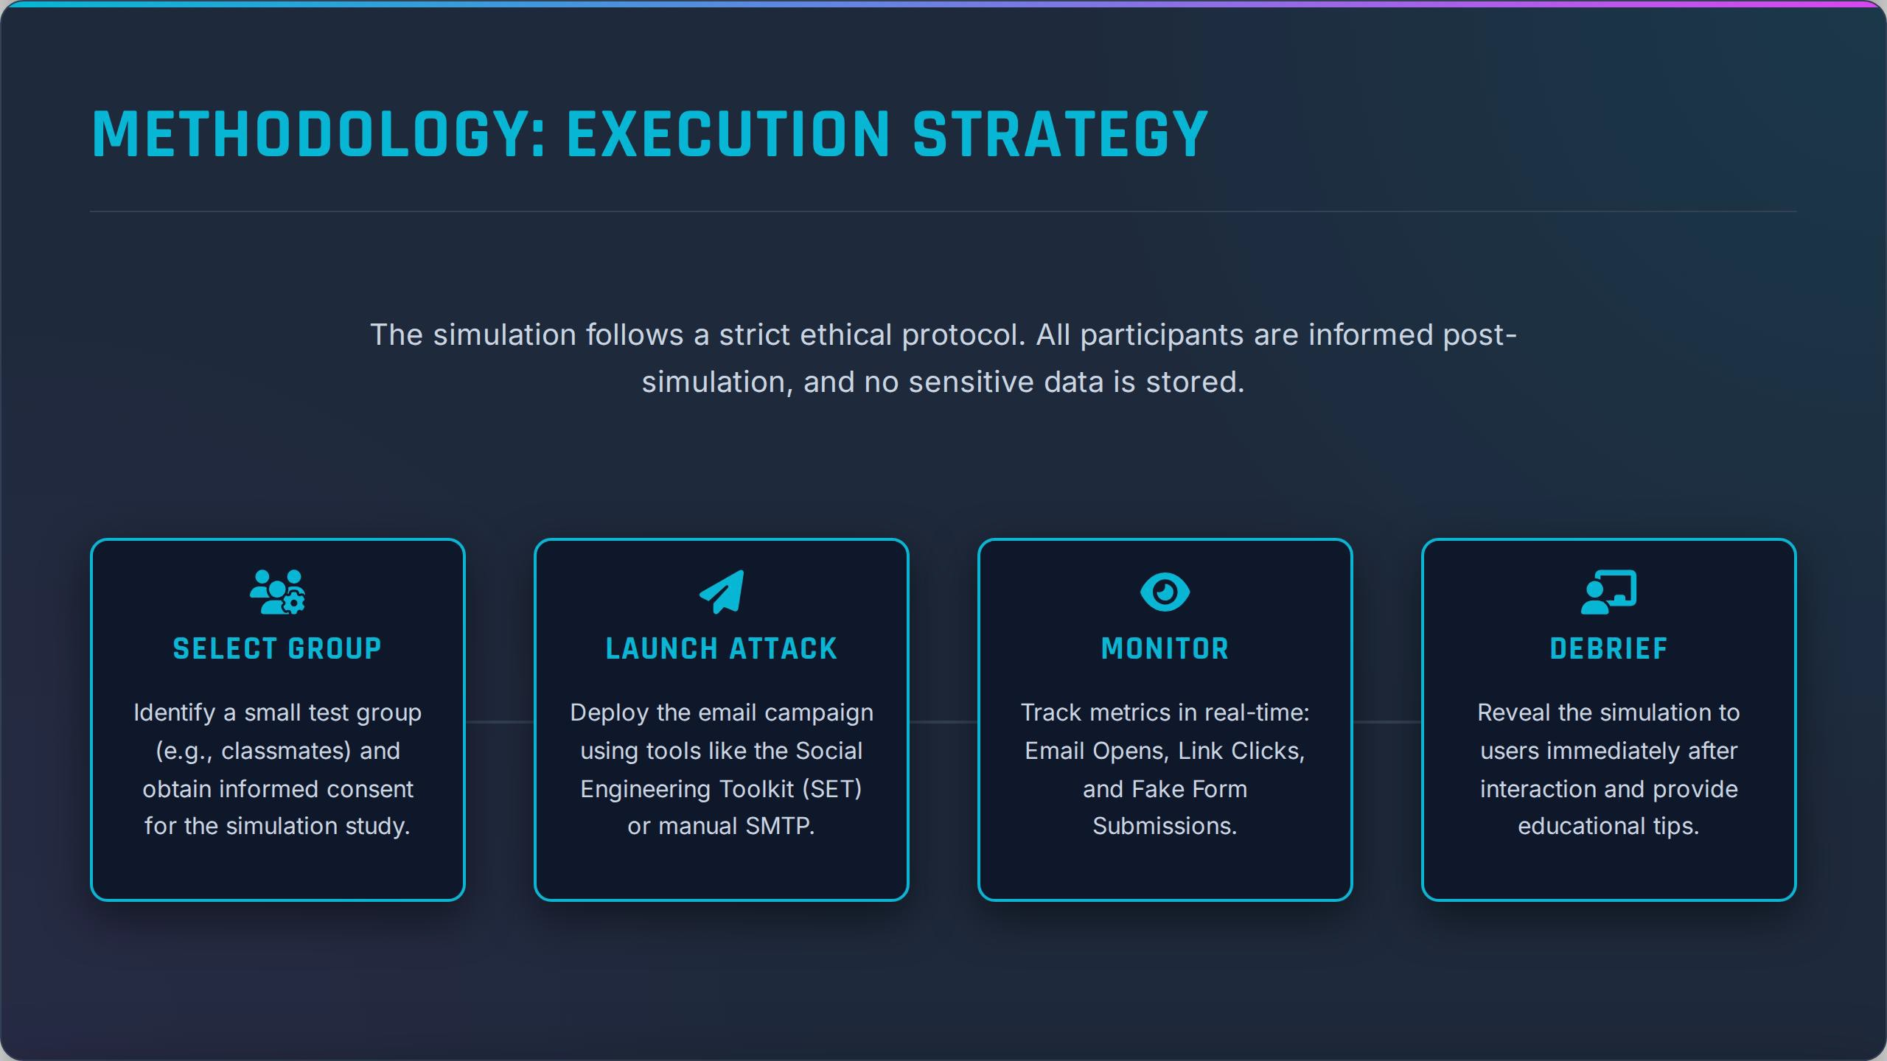

Slide 5
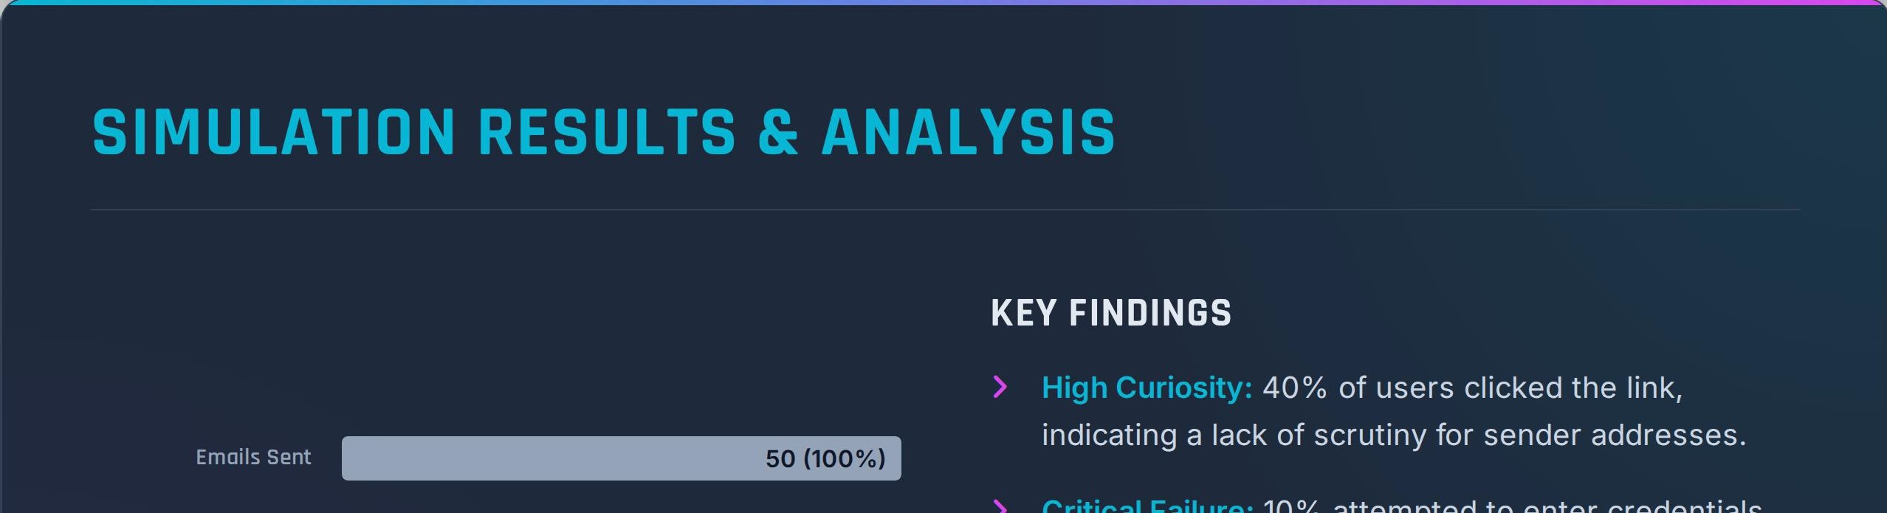
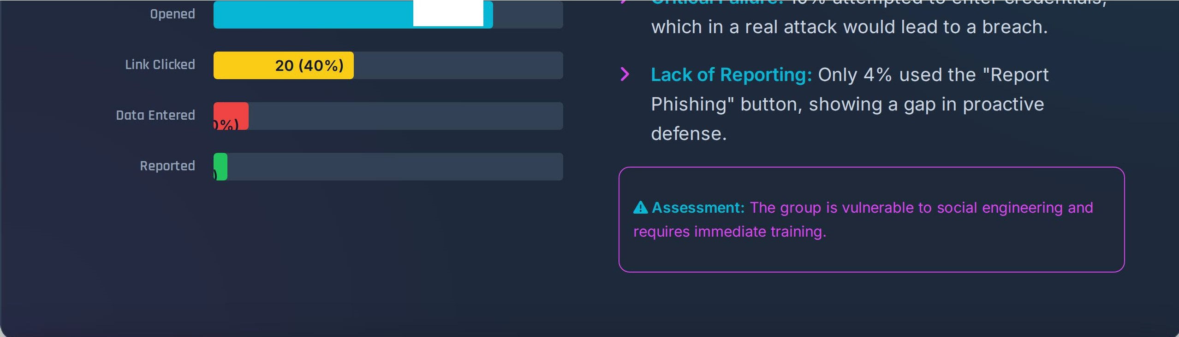
40 (80%)

Slide 6
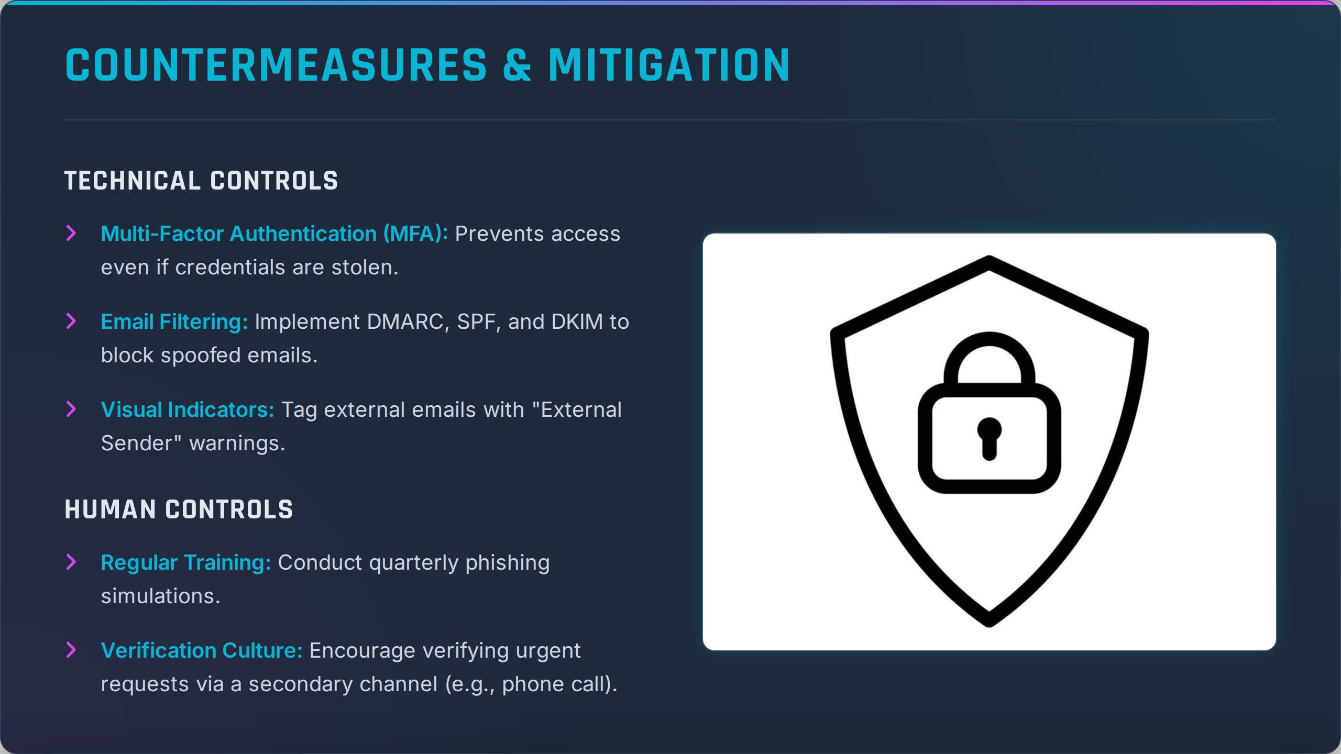

Slide 7
PROJECT DELIVERABLES
Upon completion of the simulation, the following artifacts have been generated:
fof COMPREHENSIVE REPORT
�
EVIDENCE SCREENSHOTS
Detailed methodology, click-rate analysis, user behavior breakdown,
Captures of the fake login page, the phishing email template, and the
and executive summary.
analytics dashboard.
() MITIGATION PLAN
-i£l PRESENTATION DECK
A strategic roadmap for implementing MFA and employee awareness
This 7-slide summary highlighting the key risks and recommended
training programs.
actions.
Questions?
Thank You

